Slide 1
Deploying Your Trained ML Model as an API (Flask & FastAPI)
This guide will teach you how to turn your trained Machine Learning model into a working API that anyone can send data to and get predictions back. We'll use Flask and FastAPI — two popular frameworks for building APIs in Python.

Slide 2

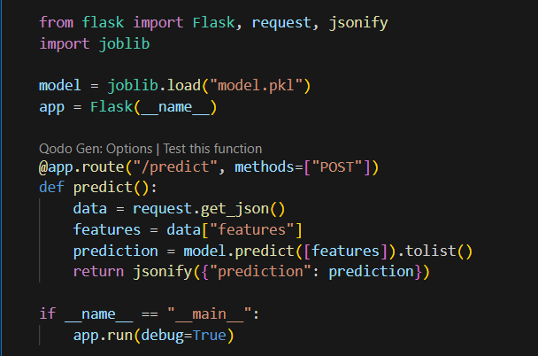
1️⃣ Step 1: Save Your Trained Model After training your ML model (for example using scikit-learn), you need to save it so you can load it later inside your API. 2️⃣ Step 2: Build API with Flask Here's how to create a simple Flask API that loads your model and serves predictions: Run the API: python app.py
Example code:

Slide 3
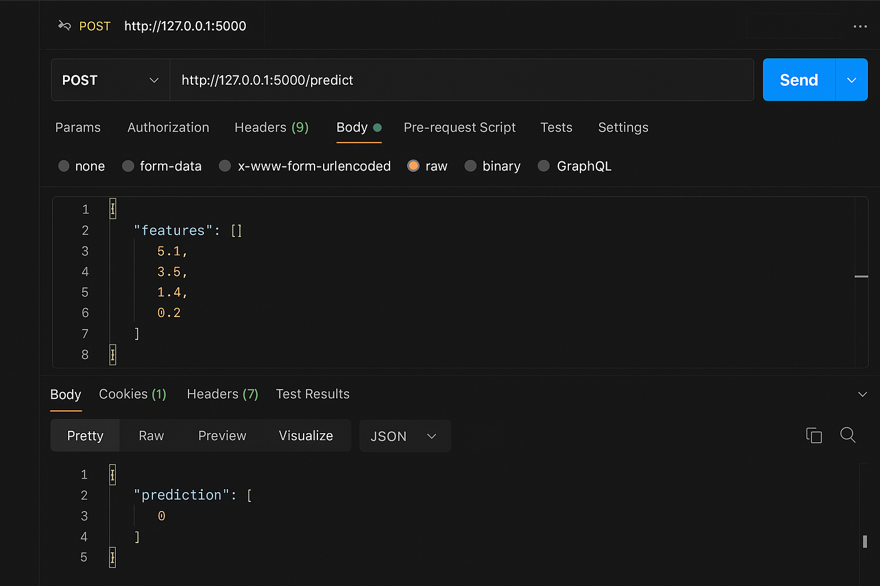
3️⃣ Step 3: Test the Flask API You can test it using curl or Postman: curl -X POST http://127.0.0.1:5000/predict -H "Content-Type: application/json" -d '{"features": [5.1, 3.5, 1.4, 0.2]}’ 💡 Note: This command sends a JSON object (features) to your API and shows the model’s prediction in the terminal. Make sure your Flask server is running before testing!

Slide 4
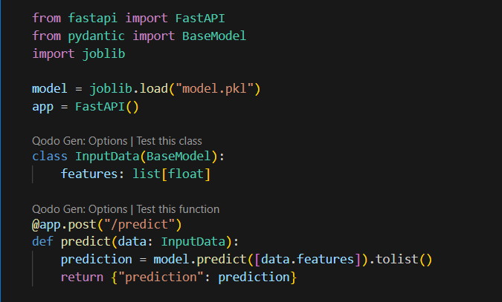
4️⃣ Step 4: Build API with FastAPI FastAPI is faster and automatically generates documentation.
Run the API: uvicorn main:app --reload
Then open in browser: http://127.0.0.1:8000/docs

Slide 5
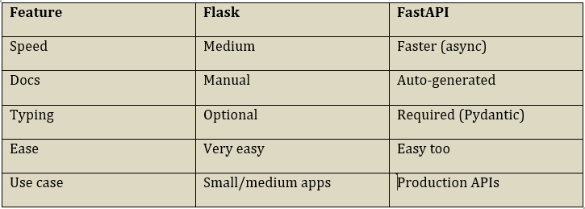
Quick Comparison :
Beginner Tips
- Flask is simpler for first-time users. - FastAPI is better for large or production-level projects. - Always test using Postman or curl. - You can host your API on Render, Railway, or Vercel.

